Slide 1

University of Pavia
Faculty of Engineering Department of Electrical,
Computer and Biomedical Engineering
Design and implementation of a 3D scanner
Supervisor: Prof. Tullio Facchinetti
Candidate:
Marko Pandža
27.09.2023

Slide 2
Summary
Context
Goals
Materials and tools
Implementation
Results
Conclusion

Slide 3
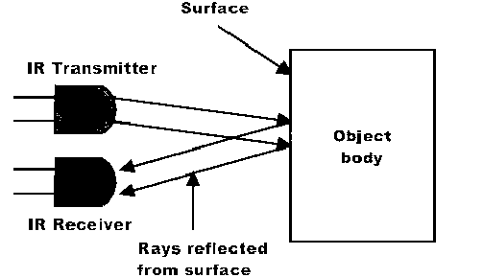
Context: 3D scanning
3D scanning is a process in which the shape and appearance of real-world objects or environments are captured and converted into a digital 3D representation

Slide 4
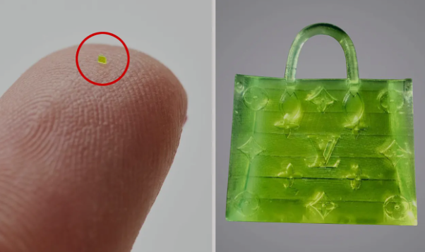
Context : 3D scanning
Where is 3D scanning used?
Quality Control
Reverse Engineering
Archaeology and Cultural Heritage Preservation
Architecture and Construction
Product Design and Prototyping
Medical Applications

Slide 5

Goals
Use low cost technology to make a 3D scanner
Enhance the accuracy and precision of the scanner while considering the constraints imposed by its costs
Conduct experiments with various tools
Select the most promising scanner and proceed to enhance its mechanical capabilities
Compare to other scanners on the market

Slide 6
Materials and tools
Stepper motor
Provides accurate steps of 1.8°
Rotates clockwise and anti-clockwise
Stepper motor driver
Enchances motor capabilities
Simplifies motor control

Slide 7
Materials and tools
Arduino
Open source with large community
Wide range of compatible peripherals
Infrared sensor
Low cost, decent accuracy
Not sensitive to ambient light

Slide 8

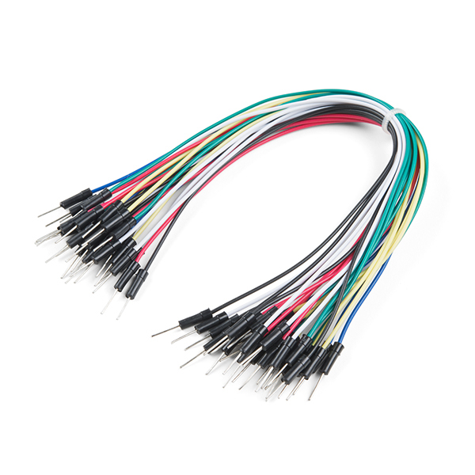
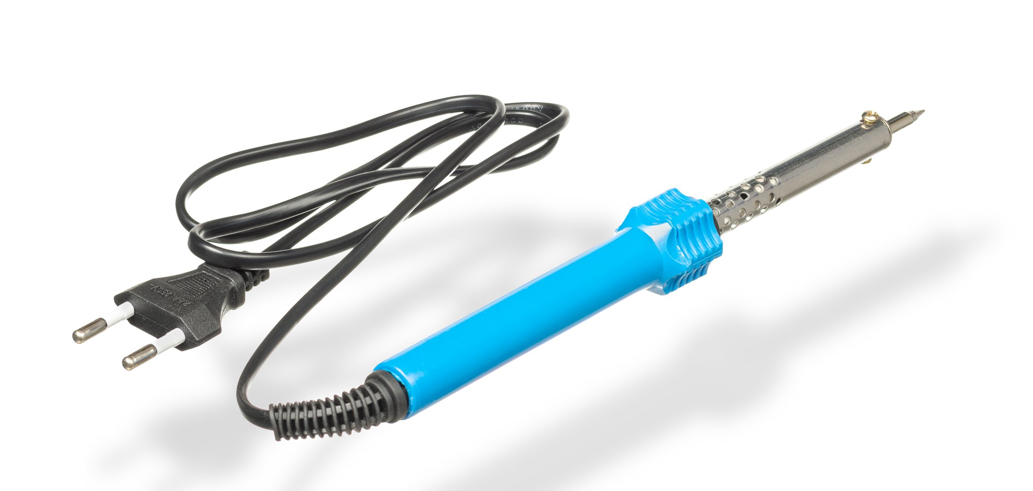
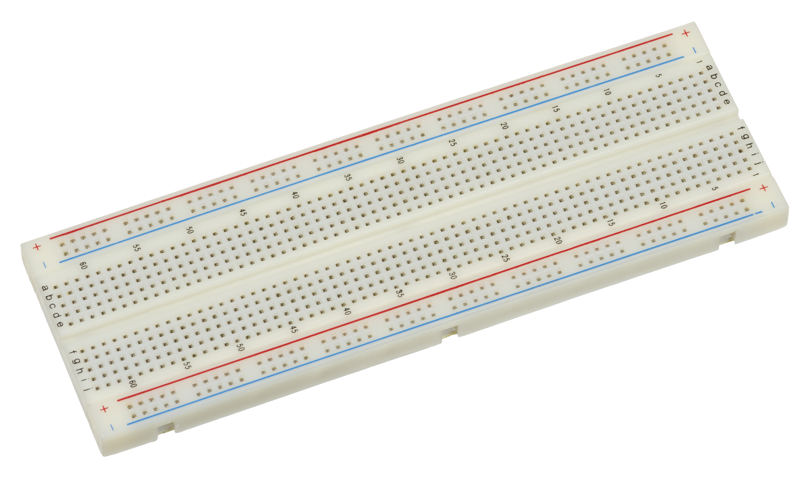

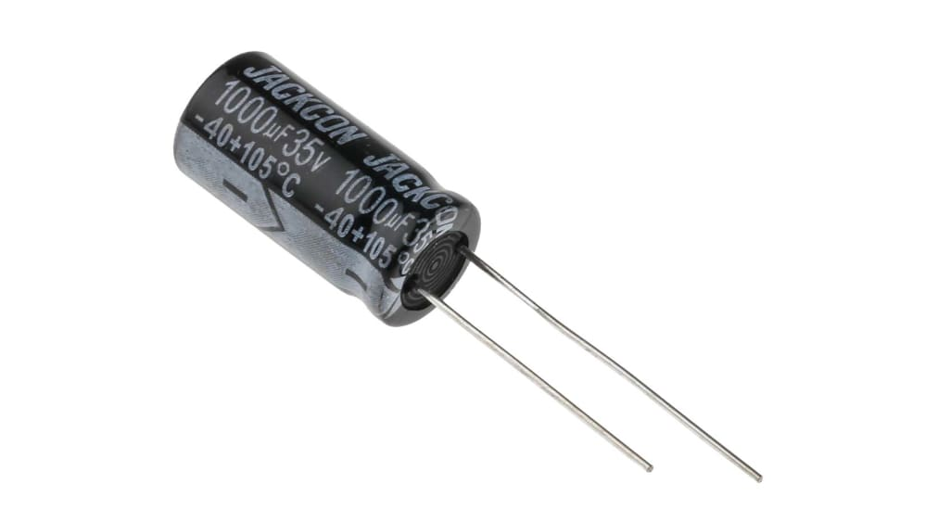

Slide 9
Implementation
Project development:
Set up stepper motors and its drivers
Set up infrared sensor
Assemble the structure
Develop the software

Slide 10
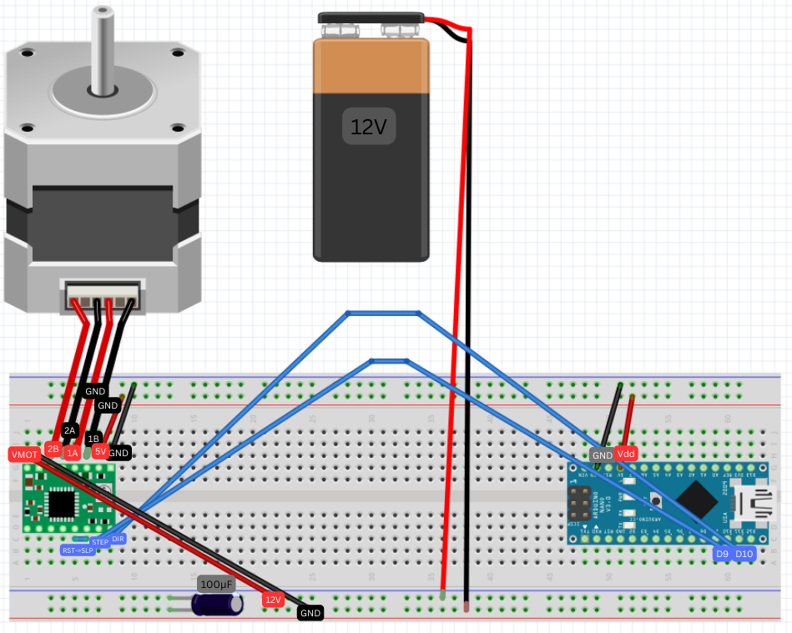
Set up stepper motor and its drivers

Slide 11
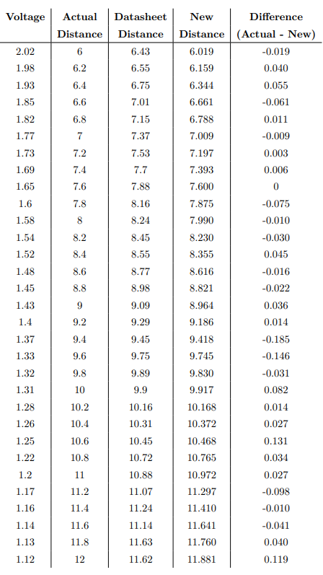
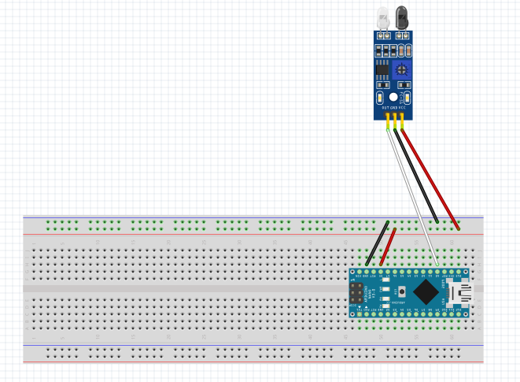
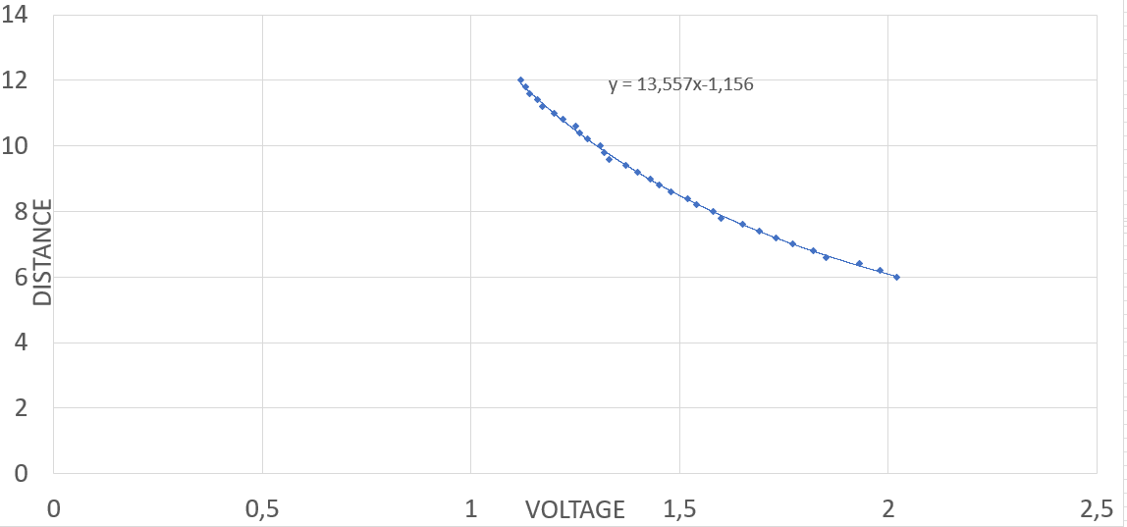
Set up infrared sensor
Connect sensor and arduino
Recalibrate the sensor

Slide 12
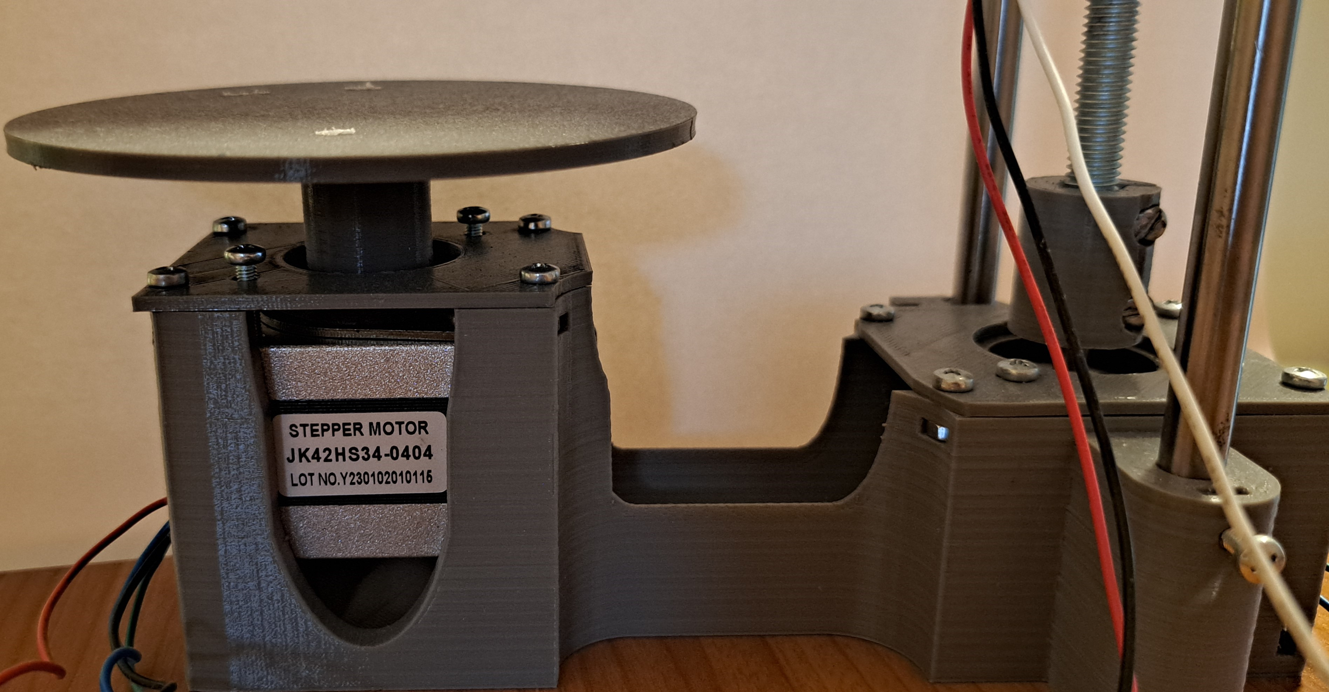
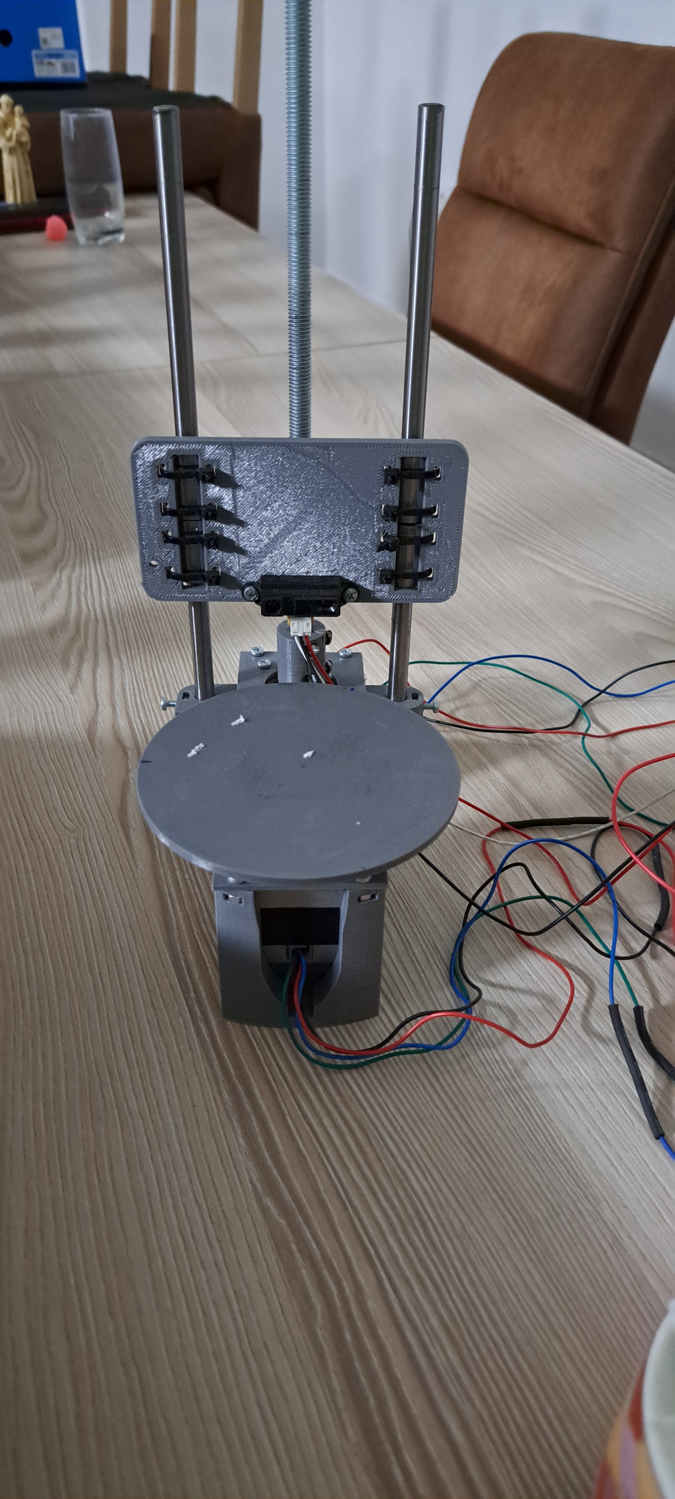
Assemble the structure
Add dampers to the motors
1
Place the motors into housing
2
Mount turntable and coupler on the motors
3
Install metal rods and bearings
4
Attach IR sensor

Slide 13
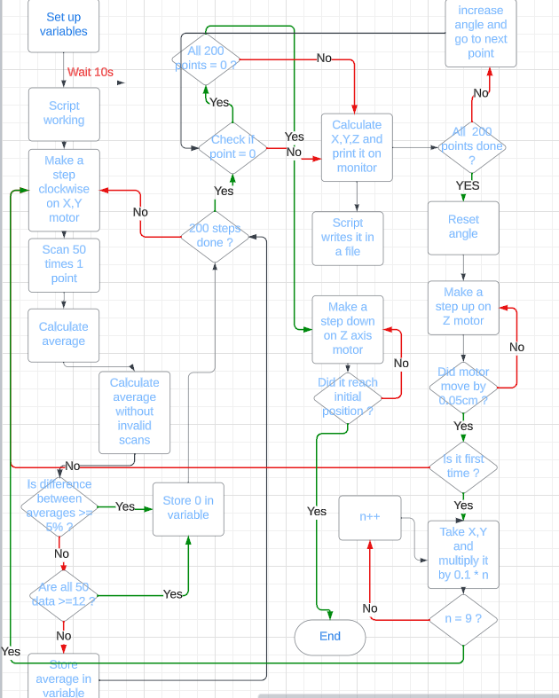
Develop the software

Slide 14
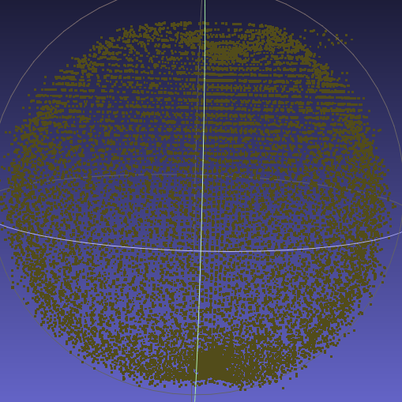
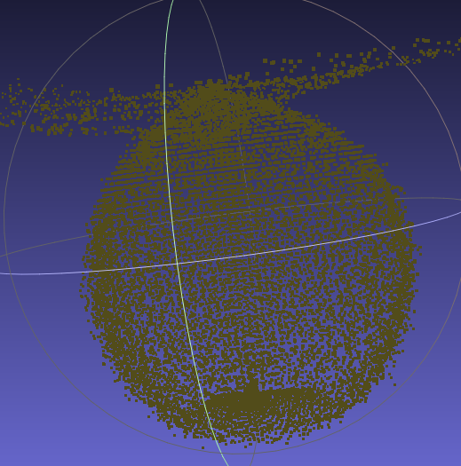
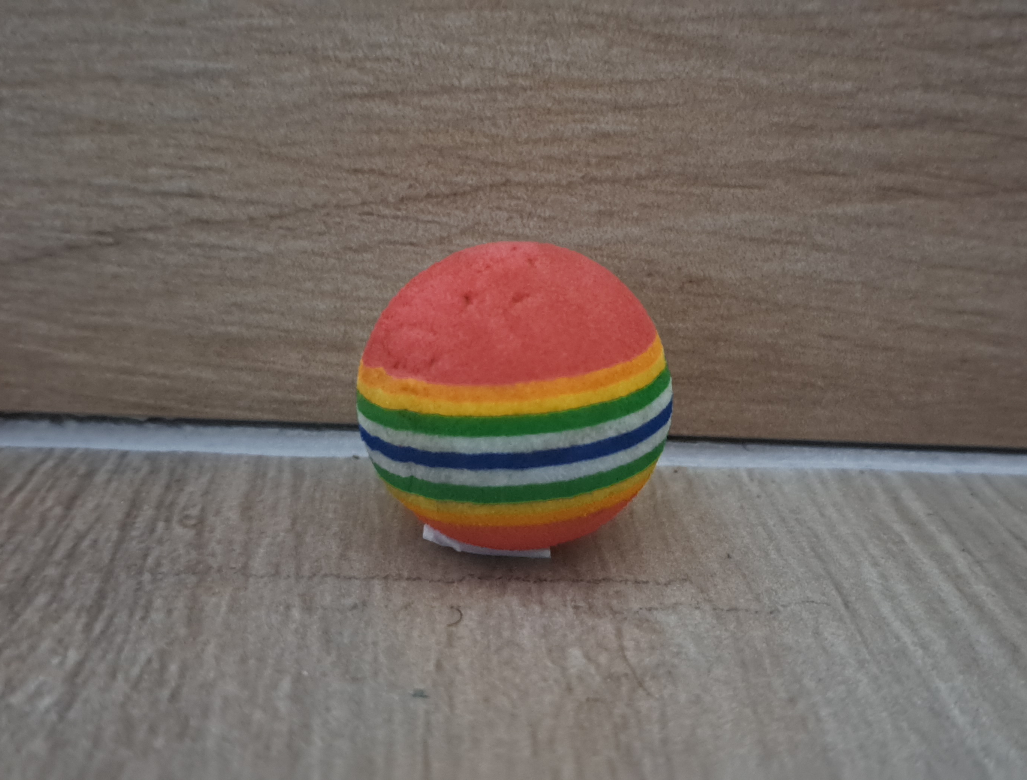
Results
Made out of sponge
Multiple colors
Not complex object to scan
0.4 mm error
IR sensor error
Commendable scan resemblance

Slide 15
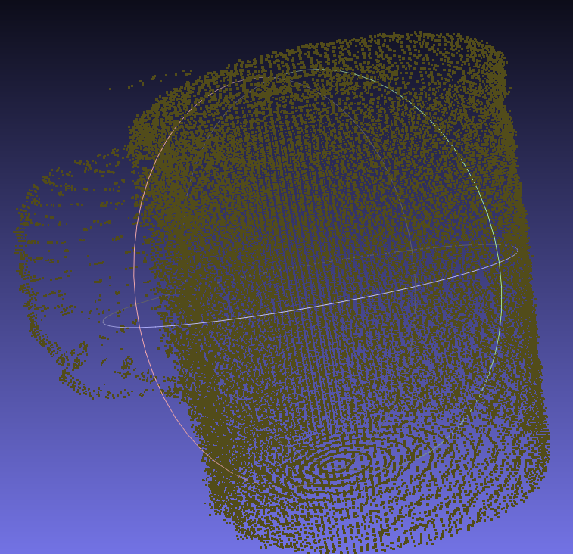
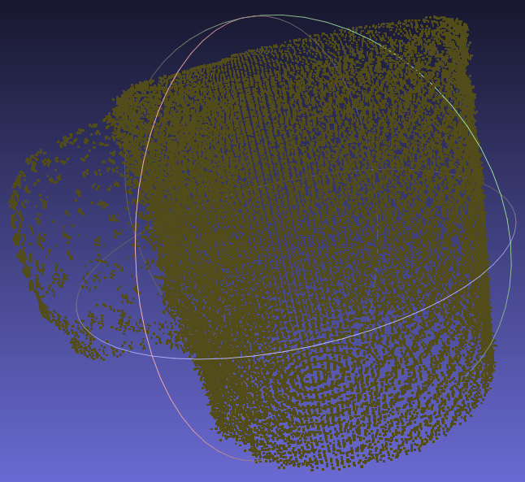
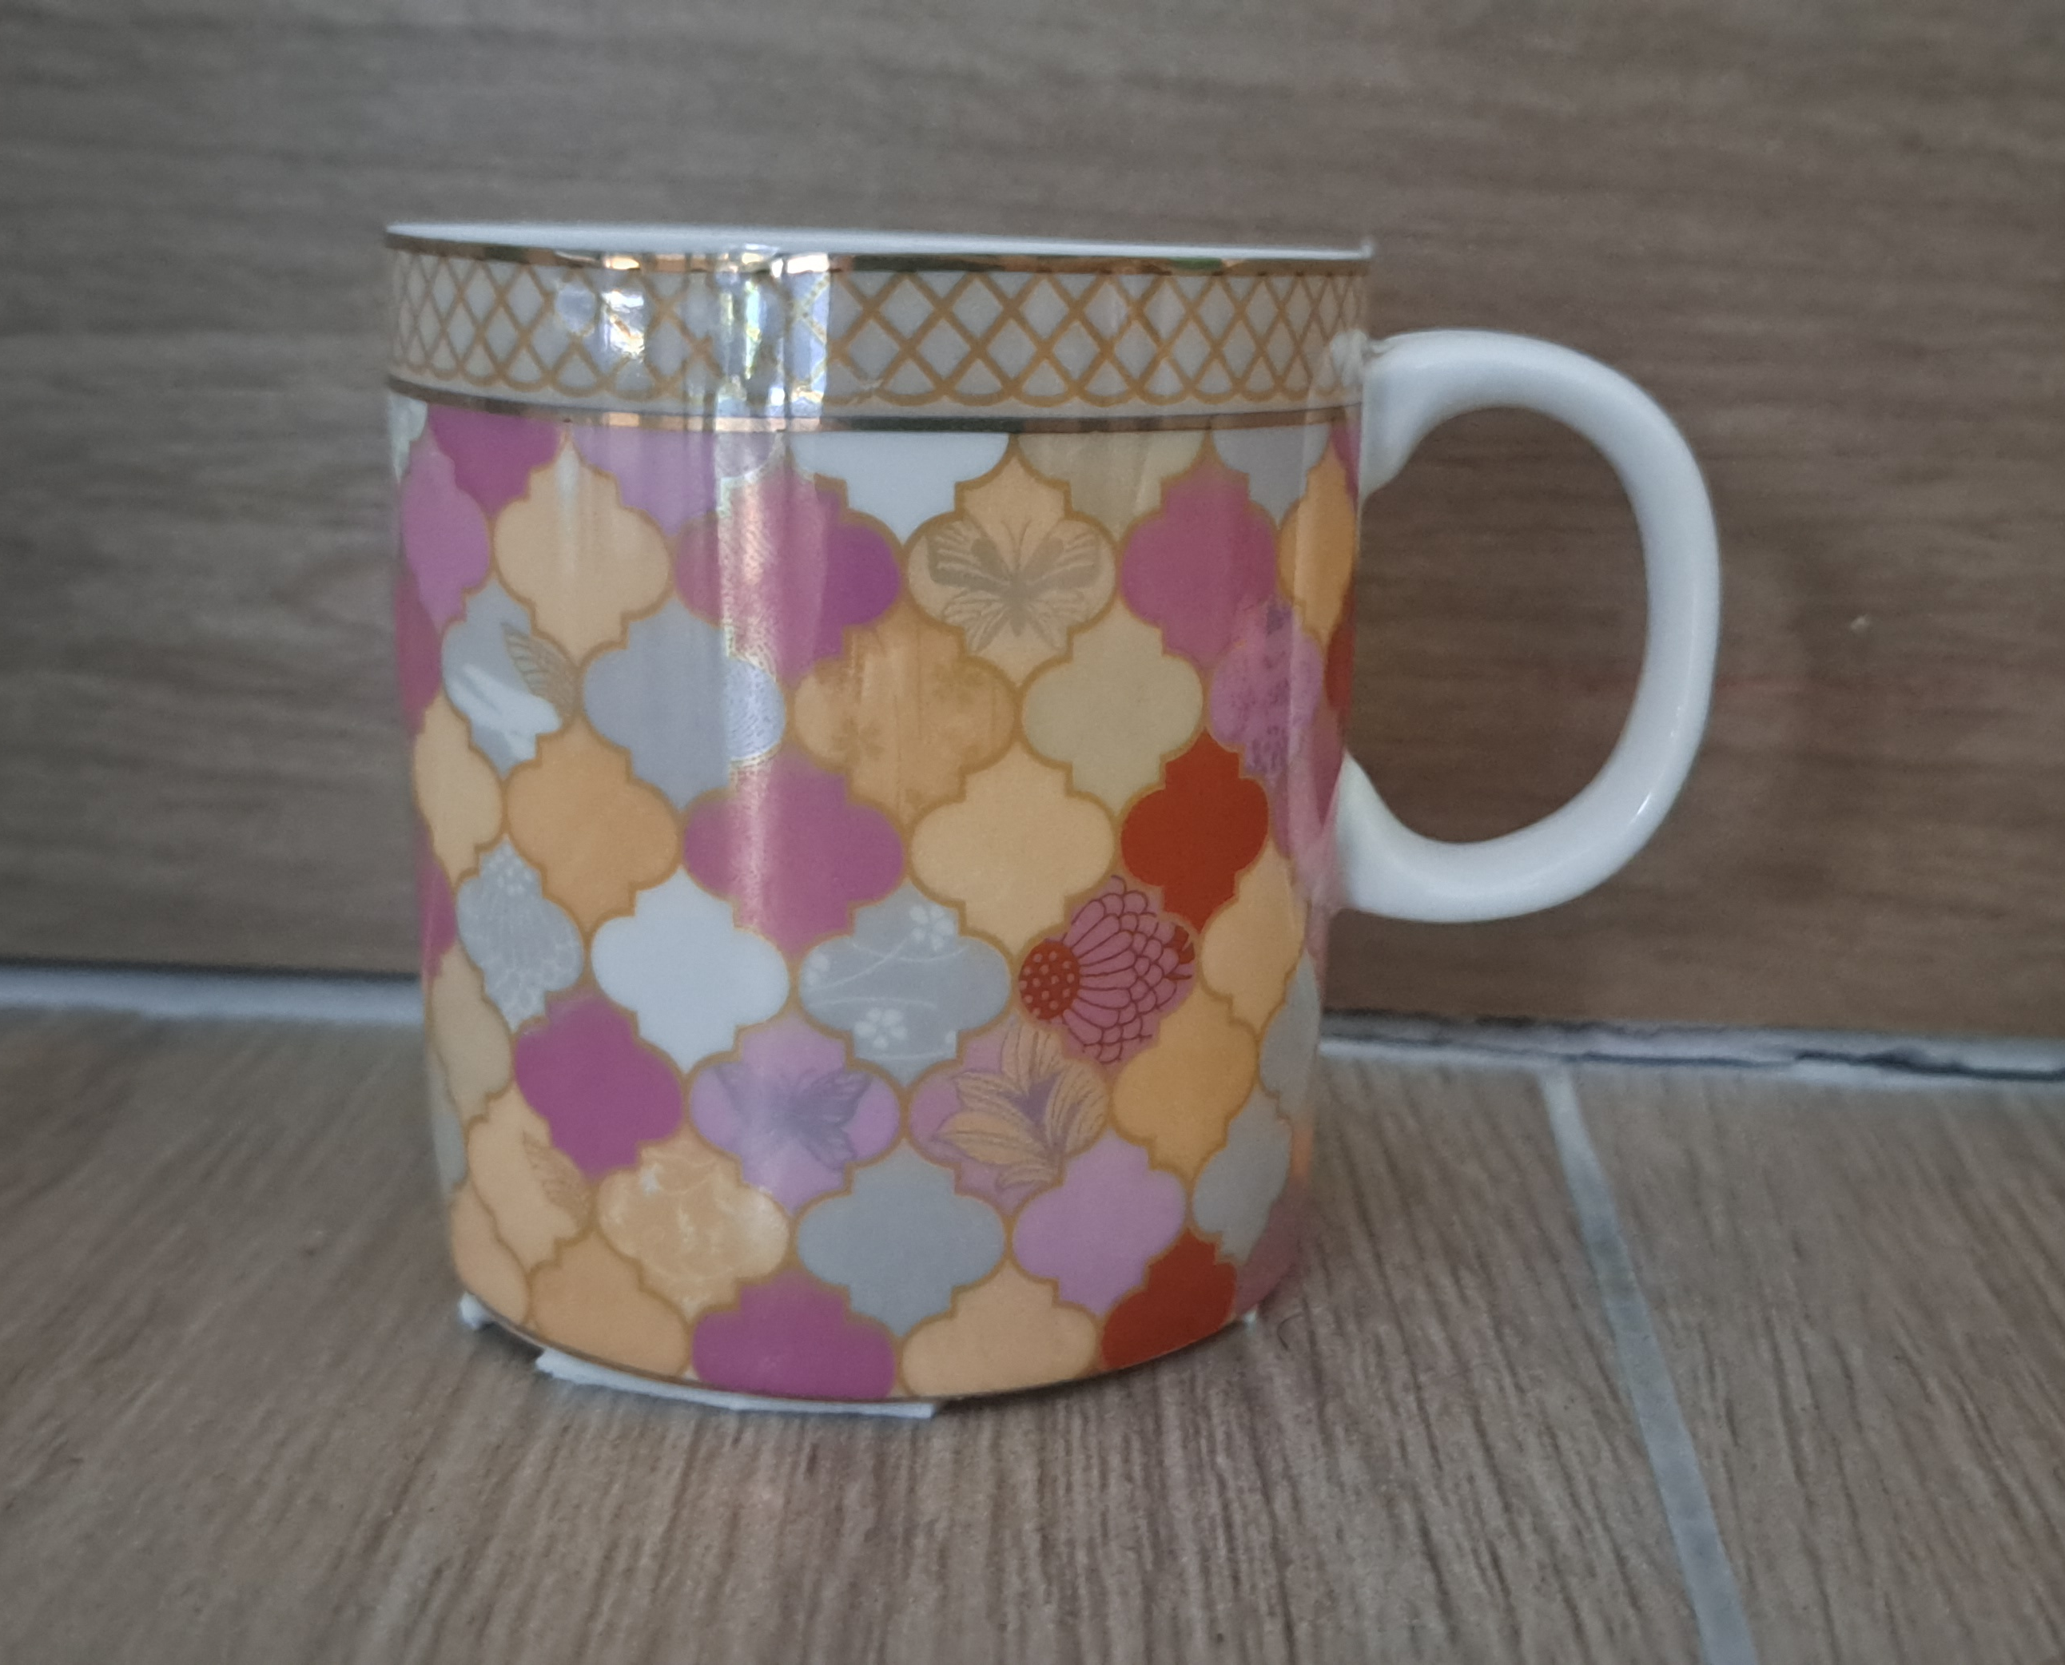
Results
Made out of ceramic
Multiple colors and reflective surface
More complex than a ball to scan
2 mm error
IR sensor error
Blind spots
Resemblance of the scan is noteworthy

Slide 16
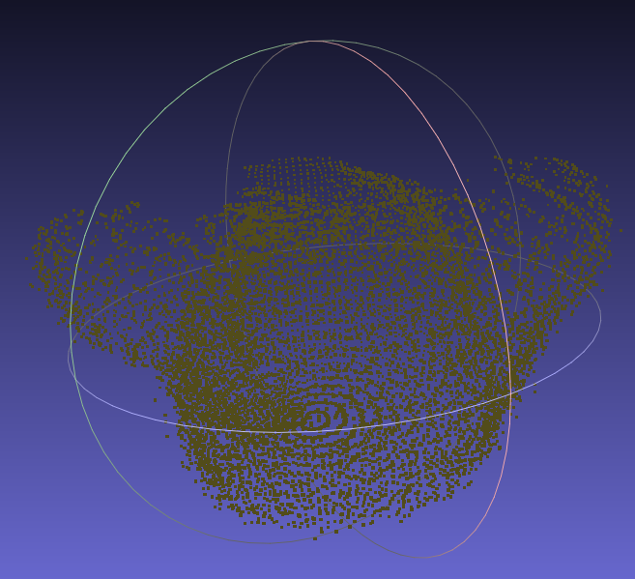
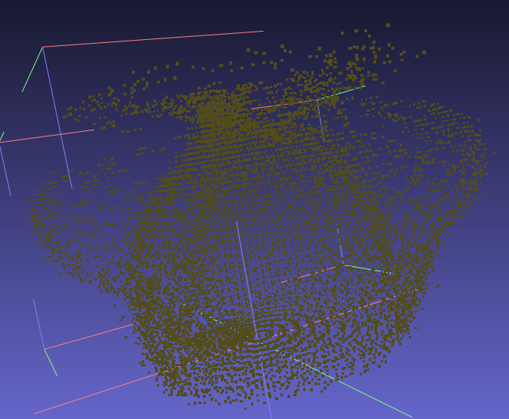
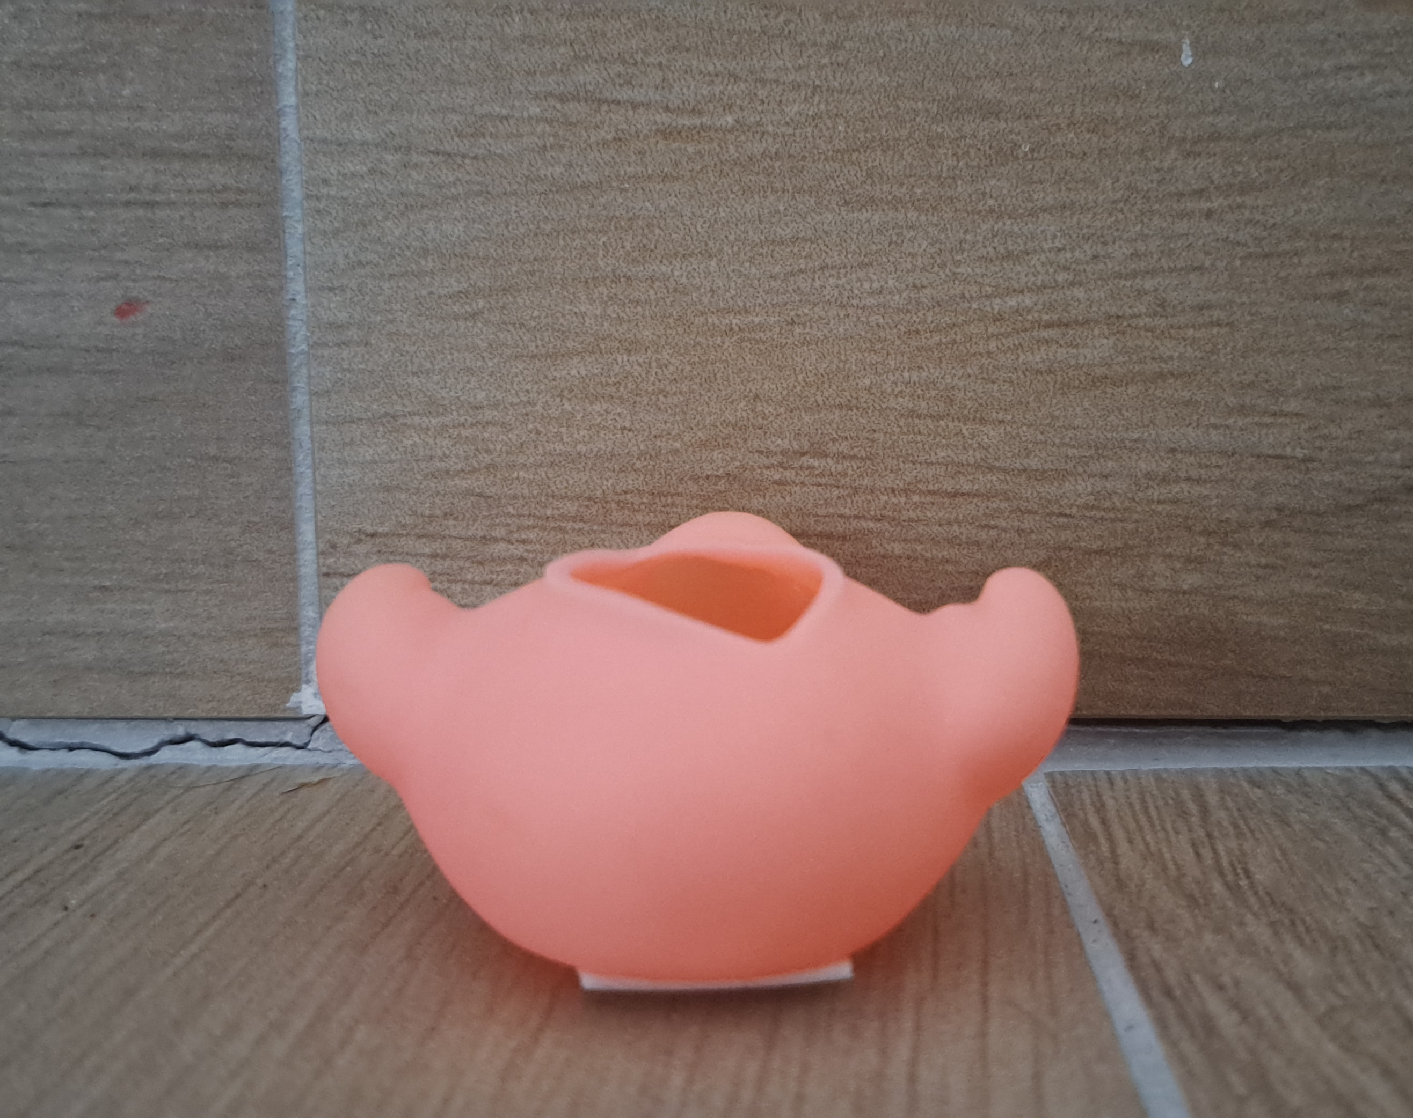
Results
Made out of rubber
Only one color
More complex than both previous items
1 mm error
IR sensor error
Satisfactory scan results

Slide 17
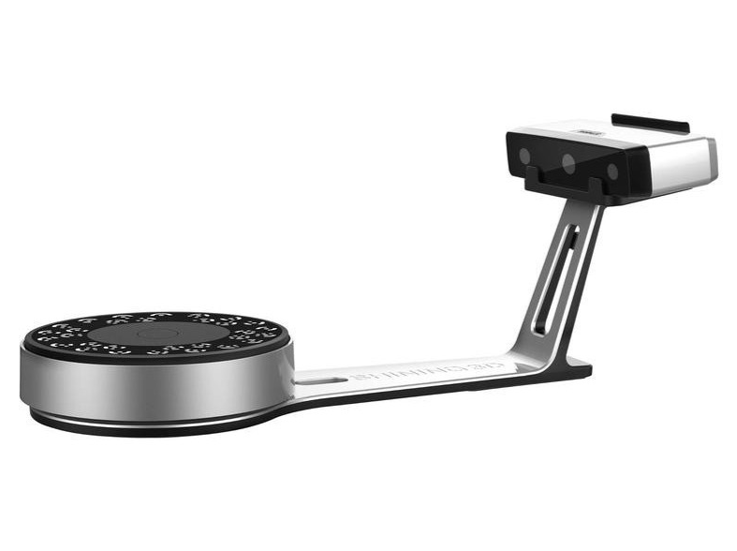
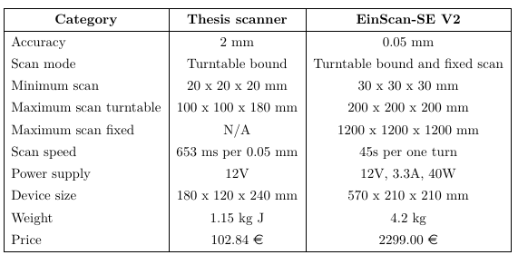
Comparison
EinScan Pros:
Superb accuracy
Can scan larger objects
EinScan Cons:
Can’t scan smaller objects
High computation power required
Heavy
Extremely expensive

Slide 18
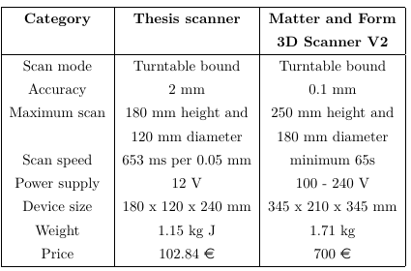
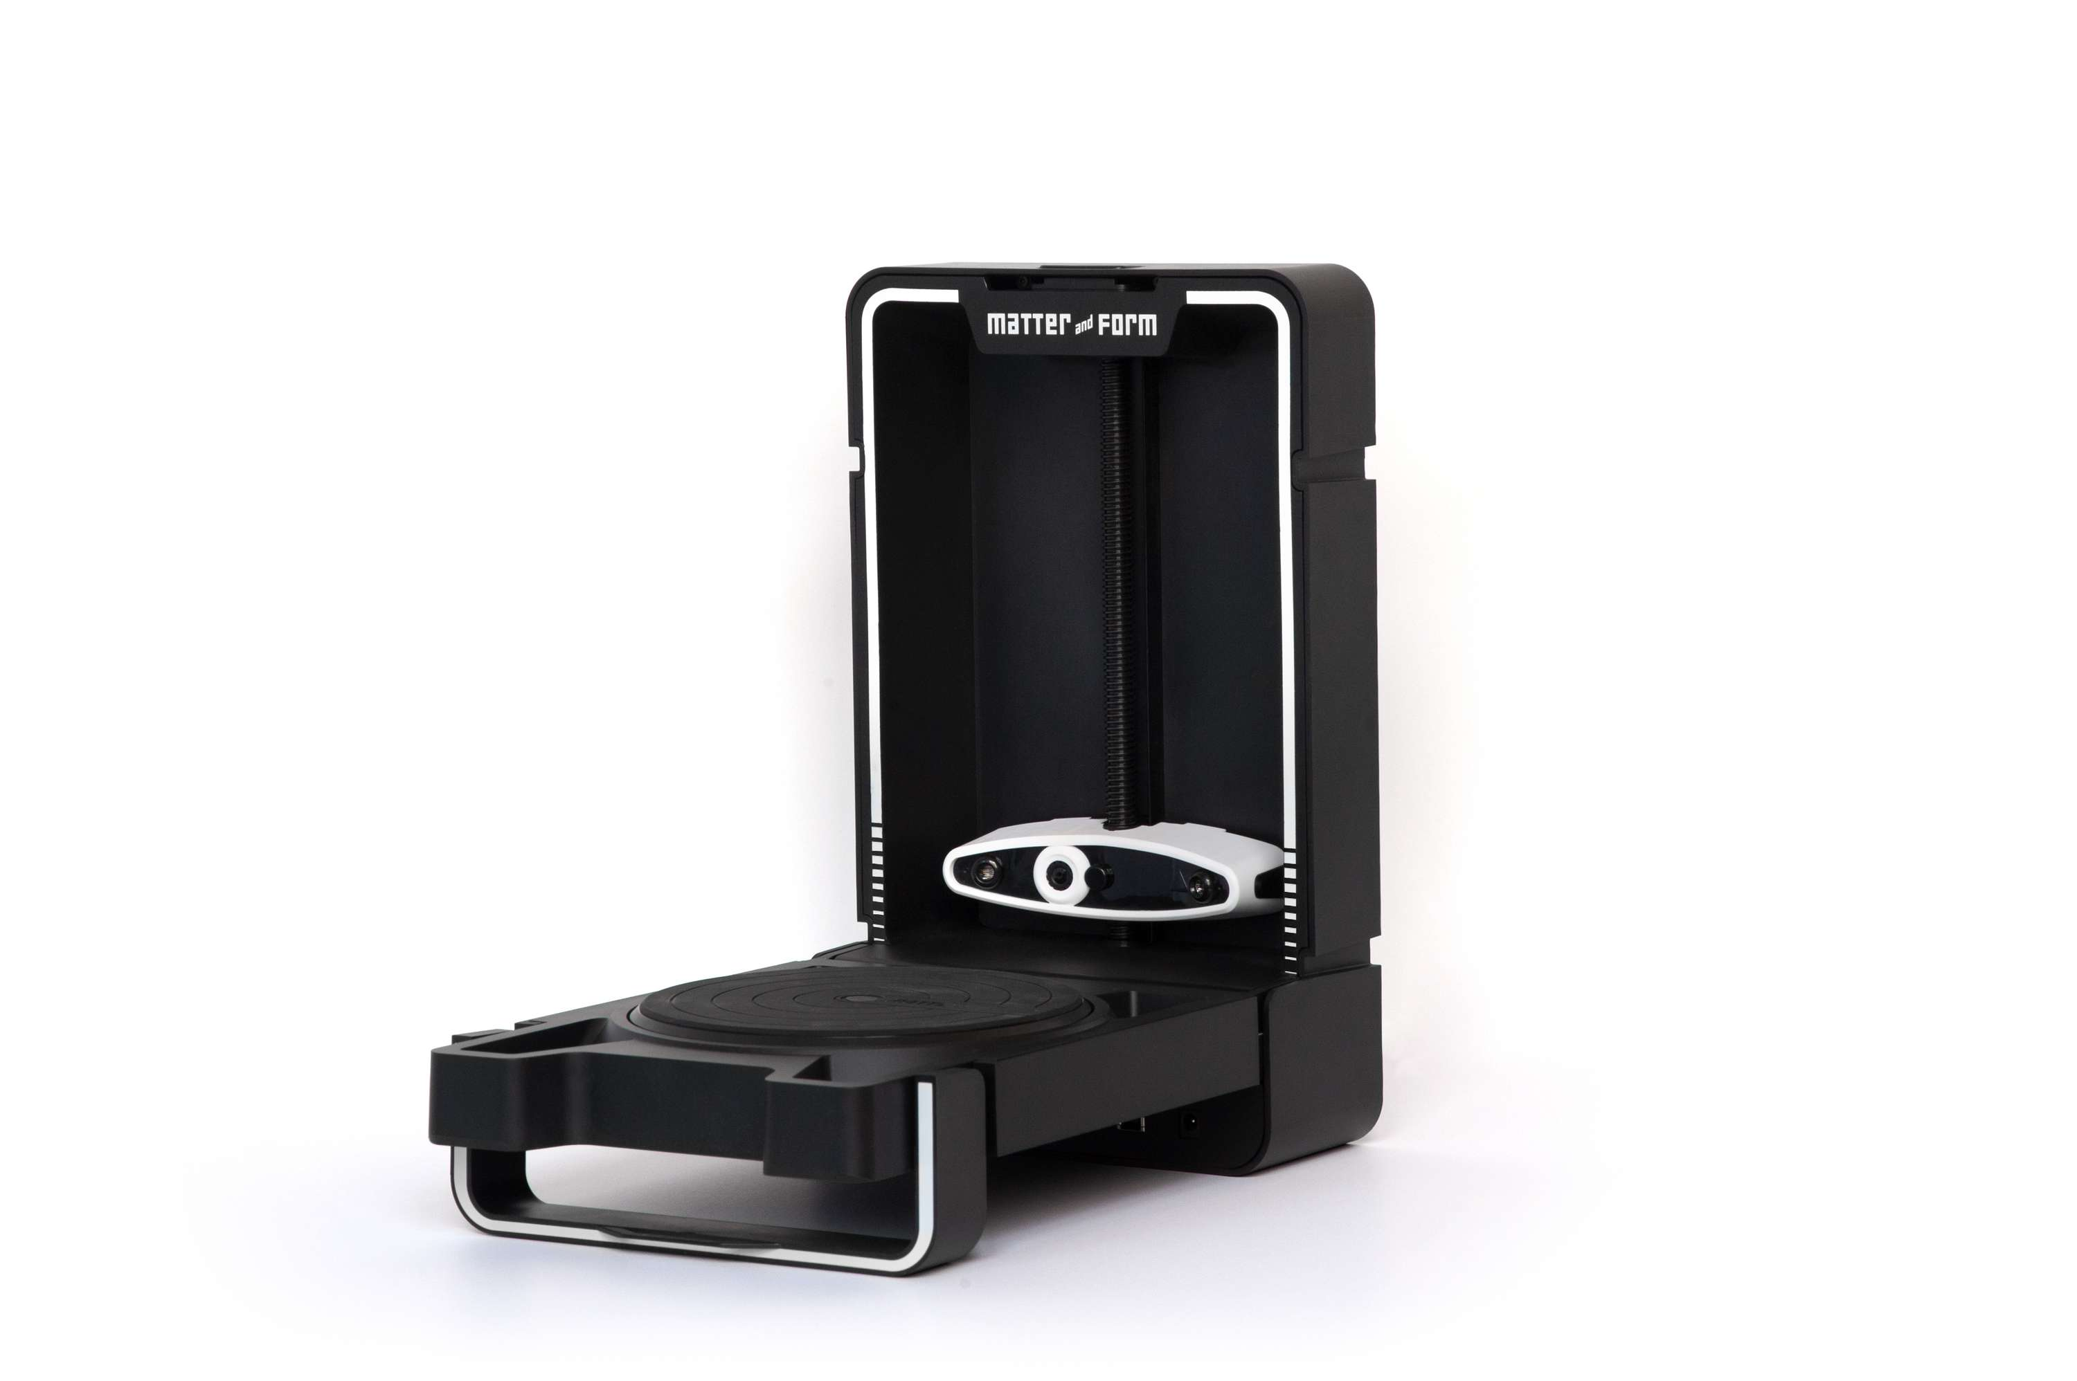
Results
Matter and Form Pros:
Better accuracy
Can scan larger objects
Matter and Form Cons:
Larger
Approx. 7 times more expensive

Slide 19
Conclusions
The accuracy of the scanner is not affected by the color of the item
The different materials do not have any effect on the scanning
Reflective surface decreases scanners accuracy
2 mm maximum noted error
The cost is much lower than existing solution
Room to improve IR sensor and still be competitive

Slide 20

Thank you for your attention

